Slide 1
Database class-1
POLLAB AHMED
SQA ENGINEER
SPRING RAIN PRIVATE LTD

Slide 2
Content
What is Database?
What is SQL?
Categories of SQL commands
SQL Data Types
SQL Queries Questionnaire
Order By
Group By
Like
Regular Expression
Aggregate functions
Case

Slide 3
What is Database?
Lets define first, what is data and what is base?
Data is a fact of any object. Human is an object and a humans hand, mouth, eyes etc. are facts.
Base can be referred as home. If we combine these 2 words together it will make database and it is meaning, a house of data in which data can be stored, retrieved and manipulated.
Modern databases are managed by the database management system (DBMS).
SQL or Structured Query Language is used to operate data stored in a database.

Slide 4
What is SQL?
Structured Query Language(SQL) as we all know is the database language by the use of which we can perform certain operations on the existing database and also we can use this language to create a database. SQL uses certain commands like Create, Drop, Insert, etc. to carry out the required tasks.

Slide 5
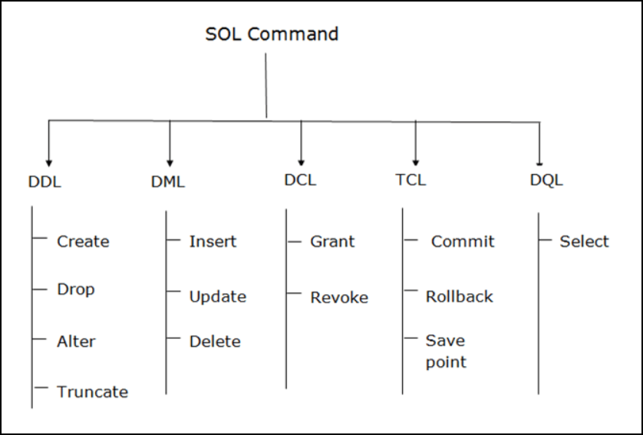
Categories of SQL Commands

Slide 6
DQL - Data Query Language
Select - It is used to retrieve data from the database.
select * from students;

Slide 7
DDL - Data Definition Language
Create - This command is used to create database or it’s objects.
Drop – This command is used to delete object from the database.
Alter – This is used to alter the structure of the database.
Truncate – This is used to remove all records from a table, including all spaces allocated for the records are removed.
Comment – This is used to add comments to the data dictionary.(--)(/*content*/)
Rename – This is used to rename an object existing in the database.(alter table student rename to students/alter table students rename column id to student_id)

Slide 8
DML - Data Manipulation Language
Insert – It is used to insert data into a table.
Update – it is used to update existing data within a table.
Delete - It is used to delete records from a database table.

Slide 9
SQL Data Types
https://www.w3schools.com/sql/sql_datatypes.asp
int, varchar, date, float/double

Slide 10
SQL Queries Questionnaire
How to create a database?
How to delete a database?
What to do before working on a database?
How will you create a table?
How to show the table?
How to delete the table?
How to rename the table?
How to add a column after the table is created?
How to drop a column from a table?
How to change a column name of a table?
How to change a column data type of a table?
How to insert data/record into a table?

Slide 11
SQL Queries Questionnaire
How to show limited numbers of data?
How to delete a data from table?
How to delete all data from a table?
How to change the auto increment value manually?
When do we use where clause?
From a table of 5 columns show any 2 columns.
How to get the data between 2 dates?
How to remove duplicate and get unique data from a table?

Slide 12
Order by
SELECT * FROM table_name ORDER BY column_name; (default ASC)
SELECT * FROM table_name ORDER BY column_name ASC;
SELECT * FROM table_name ORDER BY column_name DESC;
Order by clause will execute after where clause

Slide 13
Group by
The GROUP BY statement groups rows that have the same values into summary rows, like "find the number of customers in each country".
The GROUP BY statement is often used with aggregate functions (COUNT(), MAX(), MIN(), SUM(), AVG()) to group the result-set by one or more columns.

Slide 14
Like
a% - at the beginning
%a – at the end
a__% - must have 2 letters after a at the beginning
%__a – must have 2 letters before the end

Slide 15
Regular Expression
^ - beginning of a string
$ - end of a string
| - logical or
. – to skip a letter
[ampd] - single specific character after or before
[a-z] - single any character after or before

Slide 16
Aggregate Functions
COUNT(), MAX(), MIN(), SUM(), AVG()
The HAVING clause was added to SQL because the WHERE keyword cannot be used with aggregate functions.
We can use ‘AS’ for making alias.

Slide 17
Case
SELECT product_name, product_price,
CASE
WHEN product_price<=20 THEN 'Product price is in peoples capability.'
WHEN product_price>=30 THEN 'Product price is a bit high.'
ELSE 'Product price is out of the peoples capability.'
END AS price_measurement FROM products;

Slide 18
Any Questions?

